Slide 1
Edge Detection via
Canny Edge Detector
Dr. Binil Starly
James T. Ryan Professor
Edward P. Fitts Department of Industrial & Systems Engineering

Slide 2
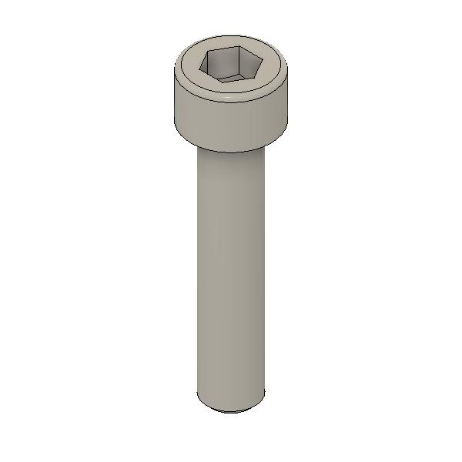
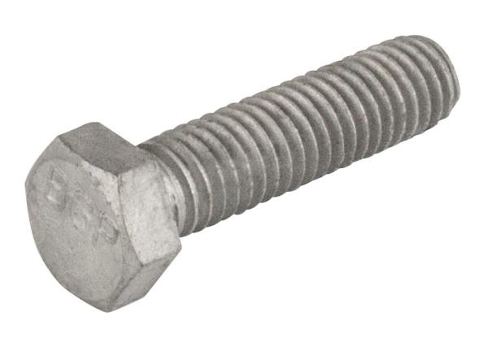
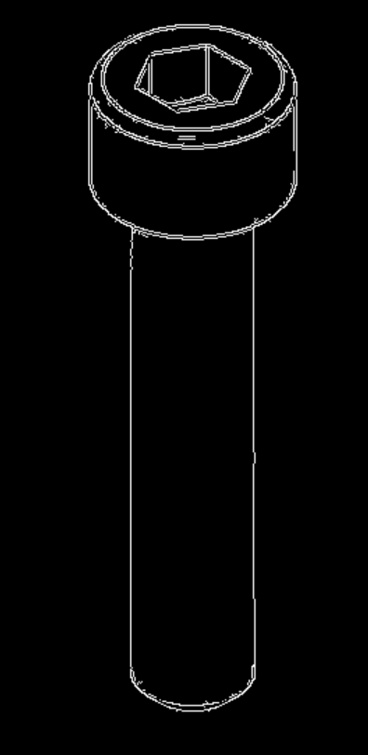
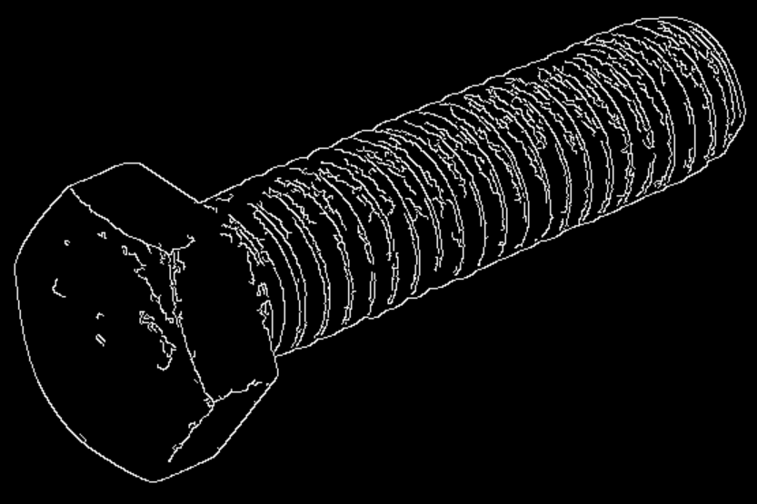
Edge Detection Algorithms
Identifying and Locating Sharp Distoniuities in an image
Various Edge Detection Algorithms:
Sobel Operator
Prewitt Operator
Laplacian of Gaussian Filter
Among the most common applied technique is the Canny Edge Detector or scientifically – the Gradient of Gaussian Edge Detectors.

Slide 3
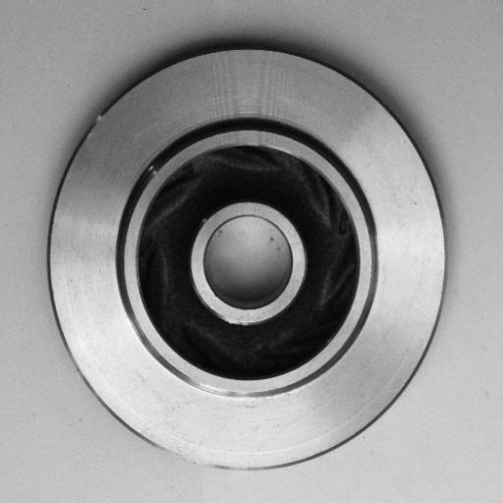

Edge Detection Criteria
Identifying and Locating Sharp Distoniuities in an image
Detection
The probability of detecting edge points to be maximized while probability of falsely detecting non-edges to be minimized. In other words this is maximizing the signal to noise ratio.
Localization
The detected edge should be close to the real edges and no gaps exist between the real vs the predicted edge.
Number of Responses
A real edge on the original image should not result in multiple edges on the digital image.

Slide 4
Canny Edge Detection Process
Multi-Stage Process
Noise Reduction
Finding Intensity Gradient of the Image
Non-Maximum Suppression
Hystersis Thresholding

Slide 5
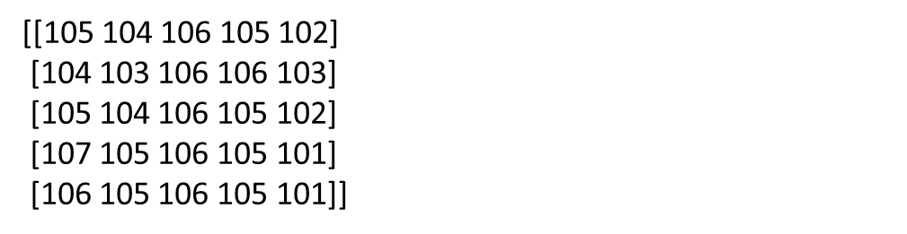
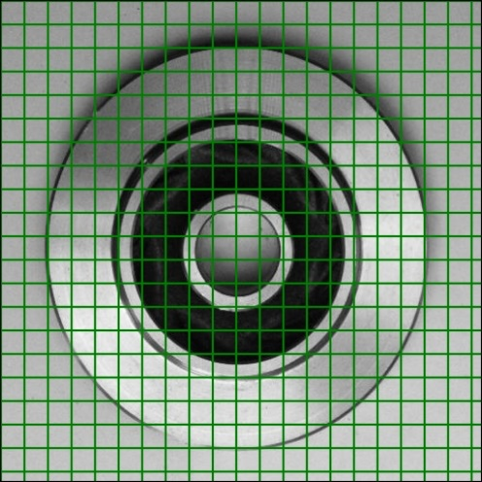
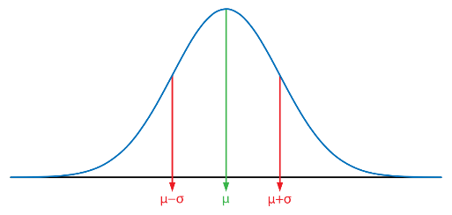
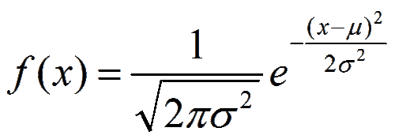

Canny Edge Detection Process
Noise Reduction by Smoothening over the image
Smoothening by a Gaussian Blur over a 5 x 5 matrix
5 x 5 Gaussian Kernel moves over each pixel of the image

Slide 6
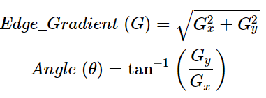
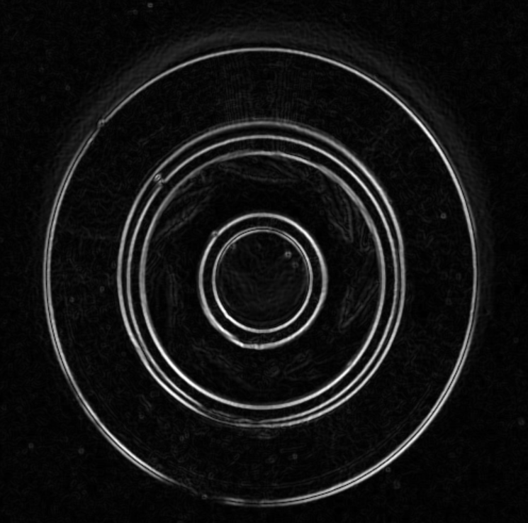
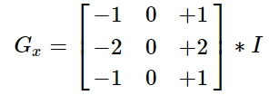
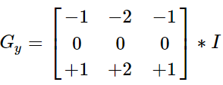
Canny Edge Detection Process
Finding the Edge Strength on the Smoothened Image
Edge Strength by using a Sobel Operator in the x and y direction of the image to yield 2 images
Smoothened image is then filtered with a Sobel kernel to get first derivative in horizontal direction and vertical direction Gx and Gy. From these two images, we can find edge gradient and direction for each pixel as follows:
Gradient direction is always perpendicular to edges. It is rounded to one of four angles representing vertical, horizontal and two diagonal directions.

Slide 7
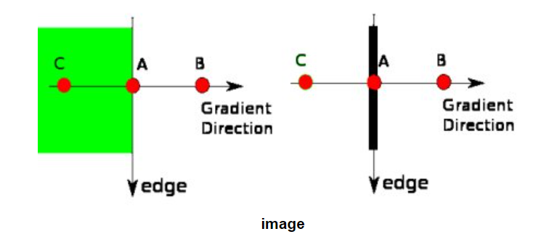
Canny Edge Detection Process
Detecting which pixels are on the edge, find them and suppress every other pixel
Non-maximum Suppression
After getting gradient magnitude and direction, a full scan of image is done to remove any unwanted pixels which may not constitute the edge. For this, at every pixel, pixel is checked if it is a local maximum in its neighborhood in the direction of gradient.

Slide 8
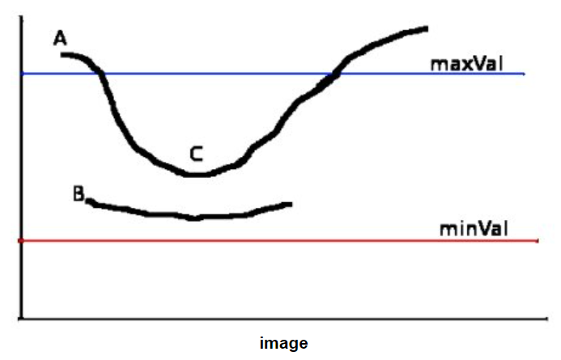
Canny Edge Detection Process
Finding the Edge Strength on the Smoothened Image
Hystersis Thresholding (minVal, maxVal)
Any edges with intensity gradient more than maxVal are regarded as edges and those below minVal are discarded as non-edges. Those edge pixels that lie between these two thresholds are classified edges or non-edges based on their connectivity. If they are connected to "sure-edge" pixels, they are considered to be part of edges. Otherwise, they are also discarded.

Slide 9
Canny Edge Detection Process
Ultimately – the Gaussian Filter size and the minVal and maxVal are the parameters
detected_edges = cv2.Canny(img, low_threshold, high_threshold, kernel_size)

